Slide 1
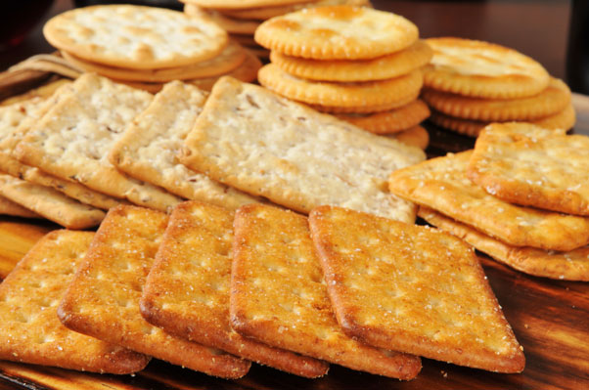
Radio Frequency Post-Baking Dryers and their Role in the Prevention of Checking
by:
Tim Clark, Pres. & CEO
Radio Frequency Company, Inc.
Notes:
This presentation will primarily cover the application of Radio Frequency in the baking process and its effect on moisture uniformity and checking, but will also touch on what it is, how it works, and how it can increase the overall efficiency of the baking process.

Slide 2
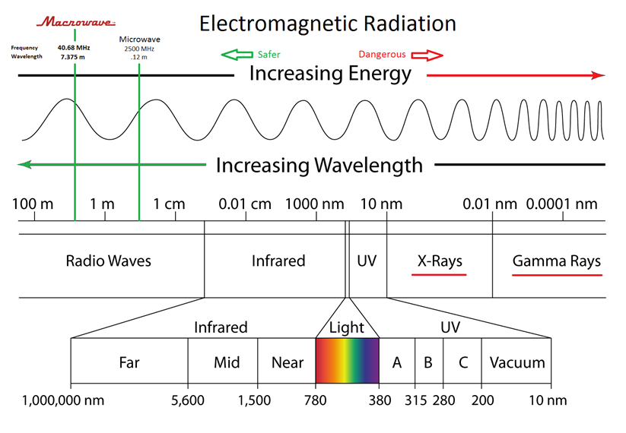
What is it?
Electromagnetic Energy Spectrum
Radio Frequency
Notes:
Here we have the Electromagnetic Energy Spectrum with visible light toward the center. To the right we have increasing frequencies and higher energy levels out towards X-Rays and Gamma Rays which are both forms of “ionizing” radiation. Often referred to as “irradiation” when applied to foods. To the left we have decreasing frequencies and decreasing energy toward microwave and lower yet, radio waves. Both microwave and RF are forms of “nonionizing” radiation, and non to be confused with “irradiation.”

Slide 3
Is Radio Frequency Heating Safe?
RF heating is a thermal process caused by a non-ionizing electromagnetic form of energy, just like an FM radio transmitter
The USDA does not view the RF thermal process as an added ingredient. Therefore an organic product treated with RF can carry the certified organic label
Thermal Process
The FDA does not view the RF thermal process as invalidating the application of “natural” on the label, unlike irradiation, which is considered an additive, and therefore requires approval and special labeling.
Non-Additive
Clean Label

Slide 4
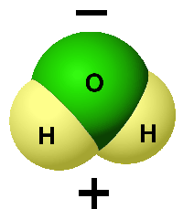
How Radio Frequency Heating Works
The unique structure of the magnetically polar water molecule, H₂O is the basis for the thermal response of water when subjected to an alternating RF energy field.
In a Radio Frequency Heating System, the RF generator creates an alternating electric field between two electrodes, above and below the conveyor.
Notes:
It’s easy to think of the behavior of a polar water molecule in an alternating electrical field, being much the same as how a bar magnet would behave in an alternating magnetic field, changing orientation to face the opposite pole.

Slide 5
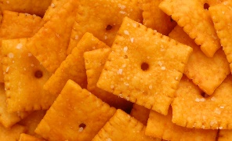
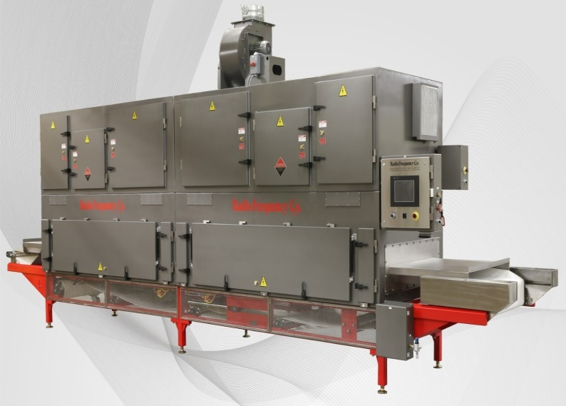
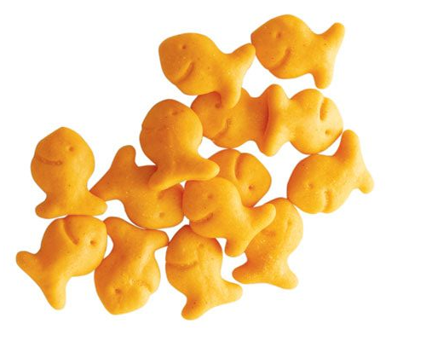
For 60 years, Radio Frequency Drying has been proven in post-baking dryers, where this technology has increased the traditional conveyorized oven efficiency and throughput capacity by as much as 50%.
RF eliminates checking and over-coloring, improves shelf-life, and also
minimizes water activity
both in human and
pet foods.
Notes:
RF is not a new technology, but a constantly improving technology and one where capital costs are actually coming down and systems are available for smaller lines where once it was employed only for higher capacity lines where the ROI was stronger.

Slide 6
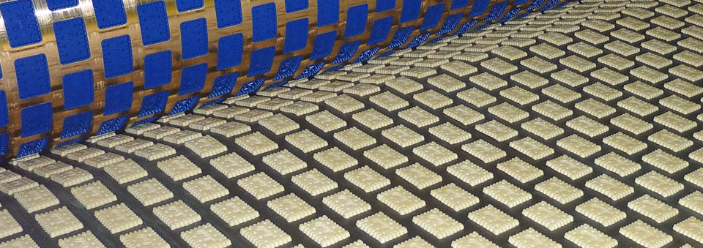
Looking at the traditional baking process, (w/o RF) it can be divided into three stages:

Slide 7
7 zone DGF/Convection Oven
Typical Bake Times can be broken down into three stages:
Product Development Stage
Baking Stage
Final Color & Dryness Stage
Notes:
Depicted at the bottom of the slide is a 7 zone DGF/convection oven for the production of snack crackers. In the first third, we have the product development stage where loft is typically developed.

Slide 8
7 zone DGF/Convection Oven
7 zone DGF/Convection Oven
Typical Bake Times can be broken down into three stages:
Product Development Stage
Baking Stage
Final Color & Dryness Stage
Notes:
The second stage we’ll call the baking stage where crumb structure is commonly set.

Slide 9
7 zone DGF/Convection Oven
7 zone DGF/Convection Oven
Typical Bake Times can be broken down into three stages:
Product Development Stage
Baking Stage
Final Color & Dryness Stage
Notes:
And the final stage, where the color is developed, and final moisture content is achieved.

Slide 10
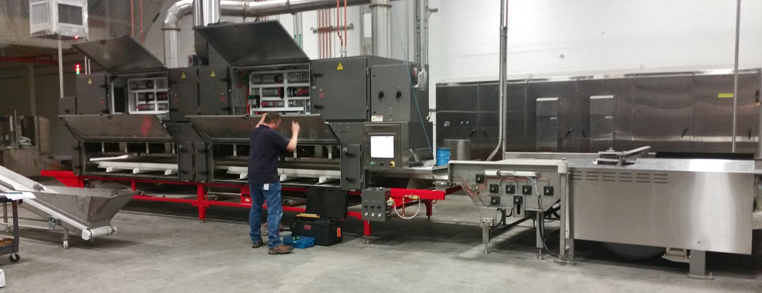
How is the Baking Process Changed when Adding an RF Post-Baking Dryer?

Slide 11
Recent Project, cheese flavored Snack Cracker > 7 zone DGF/Convection Oven with RF Post-Baking Dryer
Product Development Stage (Zones 1-3)
Baking Stage (Zones 3-5)
Color and Preliminary Drying (Zones 6-7)
Final Drying via RF (Last 4-5% Moisture)
Notes:
Here we have the same 7 zone DGF/convection oven, followed by a two-zone 200kW radio frequency dryer. The stages are only slightly changed, yet the result is quite remarkable. So, the order remains the same. Product development,

Slide 12
Recent Project, cheese flavored Snack Cracker > 7 zone DGF/Convection Oven with RF Post-Baking Dryer
Product Development Stage (Zones 1-3)
Baking Stage (Zones 3-5)
Color and Preliminary Drying (Zones 6-7)
Final Drying via RF (Last 4-5% Moisture)
Notes:
Baking stage

Slide 13
Recent Project, cheese flavored Snack Cracker > 7 zone DGF/Convection Oven with RF Post-Baking Dryer
Product Development Stage (Zones 1-3)
Baking Stage (Zones 3-5)
Color and Preliminary Drying (Zones 6-7)
Final Drying via RF (Last 4-5% Moisture)
Notes:
Color and “preliminary drying.”

Slide 14
Recent Project, cheese flavored Snack Cracker > 7 zone DGF/Convection Oven with RF Post-Baking Dryer
Product Development Stage (Zones 1-3)
Baking Stage (Zones 3-5)
Color and Preliminary Drying (Zones 6-7)
Final Drying via RF (Last 4-5% Moisture)
Notes:
And the additional fourth stage now with, final drying via RF. Typically we’re looking at no more than 4 to 5% from the target package moisture content. This is an actual line, and this is the outcome.

Slide 15
Recent Project, cheese flavored Snack Cracker > 7 zone DGF/Convection Oven with RF Post-Baking Dryer
Oven output capacity increased by 22%
From 6,250 lbs./hr. to 8,000 lbs./hr.
1,750 pounds additional product per hour
10,500,000 pounds per year (@6,000 hrs./yr.)
Checking and over-coloration virtually eliminated
Notes:
What happened with this product, on this exact line, is as follows: First, we achieved a 22% increase in output capacity simply by eliminating the ovens responsibility for final drying. W/O the RF, 6,250 pounds per hour could be produced within spec. After the RF, the output was increased to 8,000 pounds per hour. That’s 1,750 additional pounds per hour If we carry that out to a 6,000 hour year, 10,500,000 additional pounds can be produced. And, yes, checking and over coloration are virtually eliminated. So, yes, RF is a very effective tool to combat checking issues, but just as significantly, it’s a much more efficient way to produce many types of products.

Slide 16
How is this possible?
As a baked product develops crumb structure and loses moisture content, it becomes less of a thermal conductor and a greater thermal insulator. Conventional drying decreases in efficiency at this point
Notes:
If you look at a typical drying curve in a conventional oven, efficiencies tail off dramatically in the final drying stage.

Slide 17
How is this possible?
Radio Frequency drying has the unique capability to preferentially heat the moist interior of a product with 100% efficiency and creates a uniform moisture profile throughout the thickness of a baked product.
Notes:
Thus its effect on checking.

Slide 18
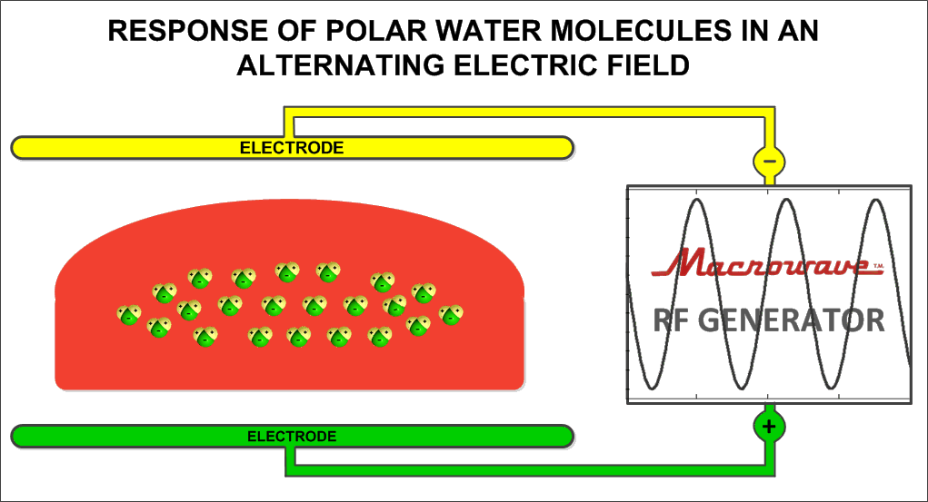
How 40 MHz Macrowave™ Drying Works
The illustration depicts a baked product within an RF post-baking dryer. Note the predominance of moisture is located in the interior of the product in the final stages of baking. Here, it can be selectively targeted and removed in seconds, with 100% efficiency.
Notes:
Here are our little polar water molecules again, constantly reorienting themselves to face the opposite poles.

Slide 19
How Radio Frequency Post-Baking Boosts Output
Conventional ovens Require a prolonged residence time for baked products to reach
their final interior dryness target. Because the thermal transfer efficiency at this stage
is low, productivity is limited
RF Post-Baking Dryers Eliminate the interior drying requirement from the oven, enabling as much as a 50% increase in band speed.
RF energy preferentially heats and dries only the moist interior of the baked product with 100% efficiency and eliminates checking
Notes:
Test notes

Slide 20
Macrowave™ Drying Eliminates Checking Caused by Differential Moisture Content / Shrinkage

Slide 21
The Radio Frequency Dryer Advantage

Slide 22
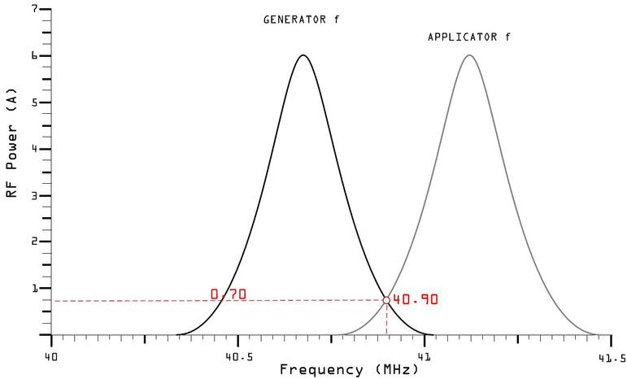
RF Power Versus Product Moisture Content
Notes:
Additionally, an RF dryer will automatically adjust power in accordance with the moisture content of the product going through it. On the left is the generator frequency, fixed at 40.68mhz. On the right, is the applicator frequency. The applicator is where the product goes through the electrode array. Think of the generator as a radio frequency transmitter, and the applicator, as a radio receiver or an antenna. As the graph shows, when these two frequency don’t match, there is very little power transferred from the generator to the applicator. What makes the applicator shift frequency and match up to generator, is the water within your products. That water, represents a capacitance value, and with basic antenna theory, we know that when you add capacitance to an antenna, you suppress it’s resonant frequency. So basically, more water, more power, less water less power. This means that a very tight final moisture spec can be maintained, even if there are moisture variations on the incoming product.

Slide 23
Typical types of Products with High Percentage of Checking
Fat free crackers
Flatbreads / Crackers with inclusions
Bread dough based crackers, e.g. pita chips
Gluten free
Coextruded treats

Slide 24
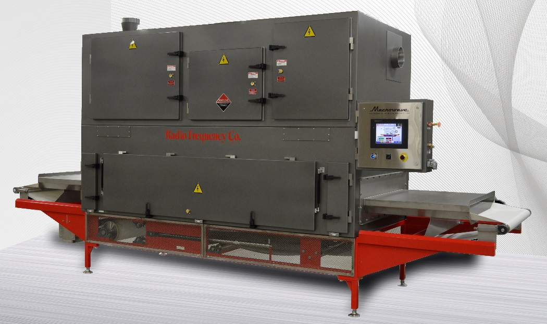
Economical Units Now Available for Smaller Throughput Requirements
Air-Cooled Design
Low Capital, installation & maintenance costs
Simple, Robust designs
Same processing benefits of larger systems
Smaller RF Post-Baking Dryers

Slide 25
Benefits of RF Post-Baking Drying
SUMMARY
Productivity
Increase Productivity up to 50% or more
Unit Energy Cost Reduction
Improve Floor-Space to Productivity Ratio
Lower Carbon Emissions
Quality
Excellent Control of Moisture Content and Uniformity
Virtually Eliminate Checking
Improve Shelf-Life
Independent Control of Color and Moisture Content
Improve Flavor Retention

